Slide 1
Data Handling Using EpiInfo
Indunil Gunawardana
Information Technology Center
University of Peradeniya

Slide 2
Data Vs Information
Data : Raw facts and figures about an organization and its business transactions
Raw data can take a variety of forms, including measurements, survey responses, and observations.
Information: Data that has been refined and organized by processing to make them meaningful in decision making

Slide 3
Example: A Mark Sheet
Name | Marks
Sunil | 89
Kamal | 76
Nimal | 45
Nayomi | 91
Total Marks | 301
Average | 75.25
Data
Information

Slide 4
Example
Price: 32/=
Weight : 80g
Manufacturer: Uniliver
Number of items sold: 20
Total earning from soap: 20 × 32/=
** Information should be – Relevant, Accurate, Understandable, Available, timely
Data
?
Information

Slide 5
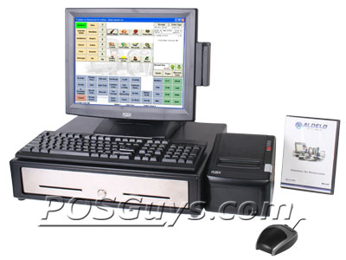
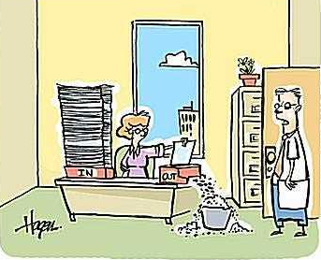
Information System
A system that generates information
Information systems can be manual or computer-based
Manual Information System
Computer Based Information System

Slide 6
Manual Vs Computer-Based Information Systems
 | Manual | Computer-based
Multitasking | Impossible | Possible
Speed | Slow | Very fast
Error rate | Higher | Negligible
Information usage | For limited number of people | For large number of people (through computer networks)
Output quality | Low quality | Higher quality
Recovery | Not efficient | Efficient

Slide 7
Which System will give you more benefits
Computer Based
Information Systems

Slide 8
What is data analysis
Data analysis is a practice in which raw data is ordered and organized so that useful information can be extracted from it.
Analysis can be done manually or using a computer

Slide 9
Advantages of Analyzing data using computer based systems
Speed of Processing
Repetitive Processing – similar tasks with a high level of accuracy
Data Storage Capacity – CD, DVD, Hard disks
Speed of Searching information
Speed of Data Communications
The Ability to Produce Different Output Formats

Slide 10
Software for Data Analysis
Microsoft Excel
SAS
OpenStat
R
MiniTab
SPSS
EPiInfo

Slide 11
About EPI INFO
A free software developed by the United States Centers for Disease Control (CDC)
Download from
http://wwwn.cdc.gov/epiinfo/html/downloads.htm
A simple software tool to create, collect, analyze, visualize and report data.
In addition, EpiInfo has analytic capabilities to summarize data

Slide 12
About EPI INFO
downloads over 1 million times over 180 countries
Translations of the programs and manual exist in 13 different languages
There are many programs available in Epi Info

Slide 13
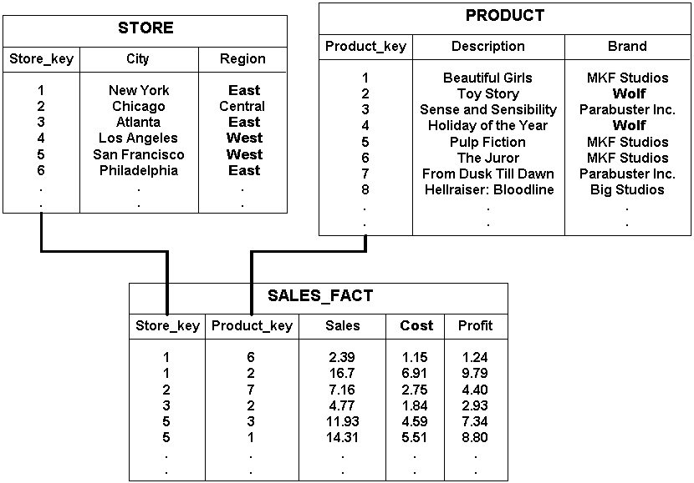
Data Storage
Data are stored in a database.
Data base has many data tables.

Slide 14
Databases
A database is a collection of organized data about one or more subjects..
A database consists of “Tables”

Slide 15
What is a Table….. ?
A table is a collection of records..
A record is information that is related to a single item.

Slide 16
Table….. ?
Field
Table - Employee
Employee No | Name | Address
100 | M S Perera | Kandy
101 | W S Asanka | Galle
102 | L K Ajith | Colombo
Record

Slide 17
What is a Primary key….. ?
A ‘Primary Key’ is a field or combination of fields which uniquely identifies the record of a table.
The primary key field must always contain a value (i.e it cannot be NULL).

Slide 18
Table - Employee
Which field can be set as the Primary key ?
NIC | Name | Address
80502458V | M S Perera | Kandy
78452422V | W S Asanka | Galle
76335462V | L K Ajith | Colombo
81201925V | M S Perera | Matara
69052241V | L K Ajith | Kandy

Slide 19
What is a Foreign key
When connecting separate data tables, the foreign key is created
A foreign key is a field that refer to the primary key of a another table.

Slide 20
Relationships……
EMPLOYEE
Employee No | Name | DepNo
Amal Perera | Name | DEP100
DEPARTMENT
Department No | Name
DEP100 | Chemistry

Slide 21
What is a DBMS?
DBMS –Data Base Management System
A DBMS is a software that facilitate to manipulate data in the database.
Eg: Ms Access, SQL server, Mysql, etc

Slide 22
Data Storage of EpiInfo
A database is created when creating a new Epi Info Project using MS Access.
Tables will be automatically created
Tables hold data for the EpiInfo Project
MS Access database must always be connected with the EpiInfo Project

Slide 23
Programs available in Epi Info
MakeView – designs questionnaires. Once a questionnaire is designed, a database is automatically created
Enter – enters data into a questionnaire
Analysis - analyzes data, report outputs, and graph data

Slide 24
Programs available in Epi Info
Maps - creates GIS maps and overlay survey data onto them
Reports – Create Reports
NutStat – Calculates z-scores

Slide 25
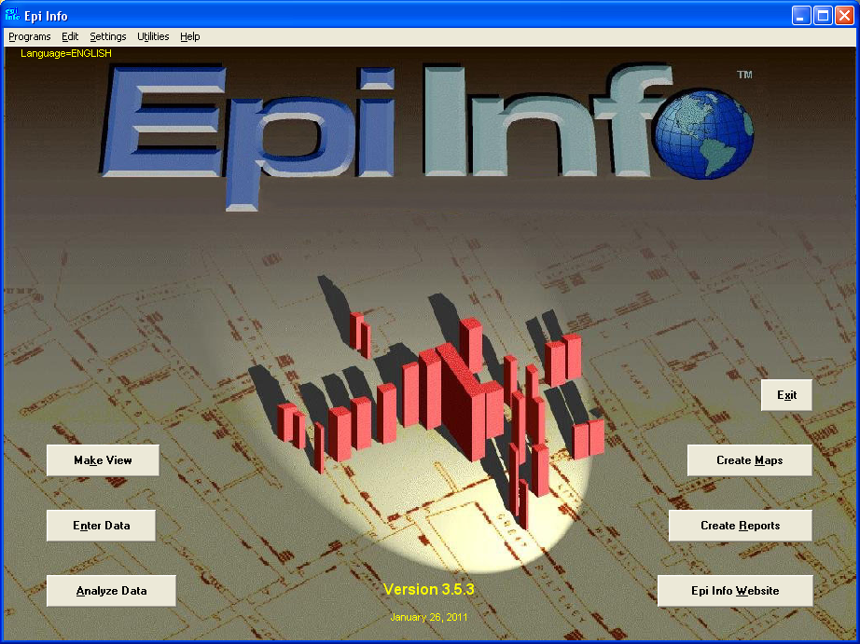
Opening EpiInfo
Clicking on the buttons will open the corresponding programs

Slide 26
Make/View Program
Displays two sections:
left side of the screen
Right side of the screen - used to design
and edit questionnaire

Slide 27
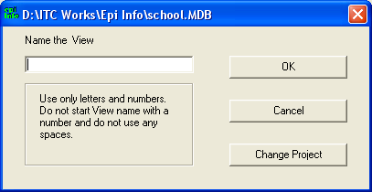
Designing a questioner
Create a new project
File → New : prompt a location to store your data ( database)
Create a new view within that project
There can be many views within a project

Slide 28
Creating a Project
New Table
Enter Data
View
DATA FORM
Existing Tables
Table-to-View

Slide 29
A project called Nutrition

Slide 30
Let us create a project called Company and a View called Employee
To collect information about employees working in a company
`

Slide 31
What is a Variable
A variable is the name for a place in the computer's memory where you store some data.
Lets consider a variable called Name- to store names
Variable: Name
Sunil
NImal
Kamal

Slide 32
Variable types
You must define variables according to the type of data we use
Available data types:-
Numeric - hold numbers.
Date - hold date values – ( the format can be defined by the user)
Custom currency – Hold currency values
String – not numeric values (text, phone number)

Slide 33
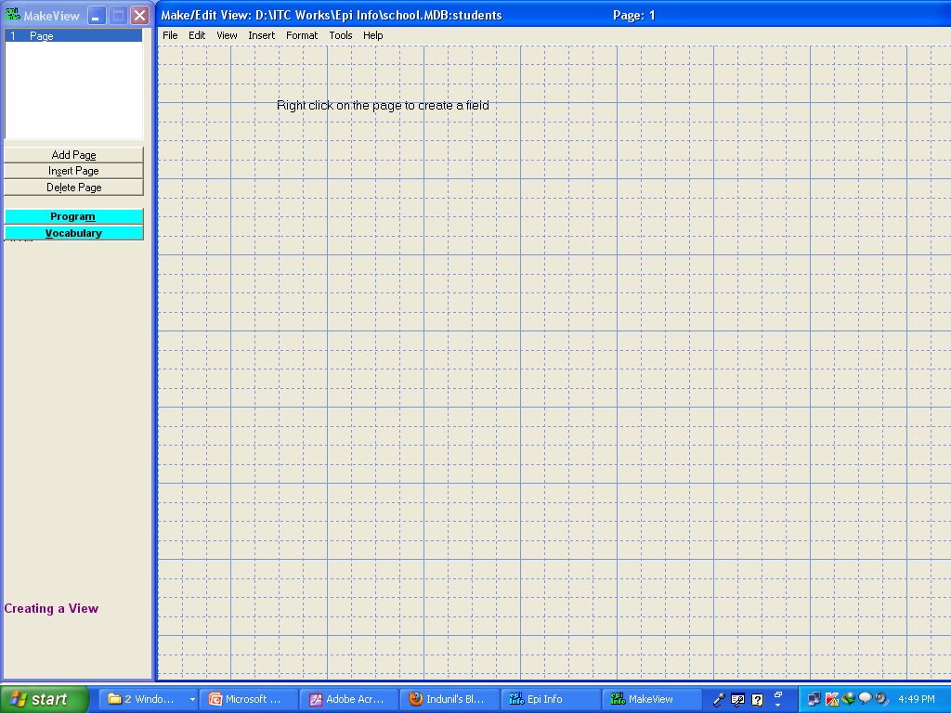

Slide 34
Fields
Each Field represents a title or a question for the survey
For example, a question, “What is the last grade you finished in school?” is treated as a field
The answer for the question are called as parameters

Slide 35
Fields
Parameters for the question above
(a) no education,
(b) primary, (c) secondary, (d) highest.
Fields and Variables are used interchangeably within Epi Info.

Slide 36
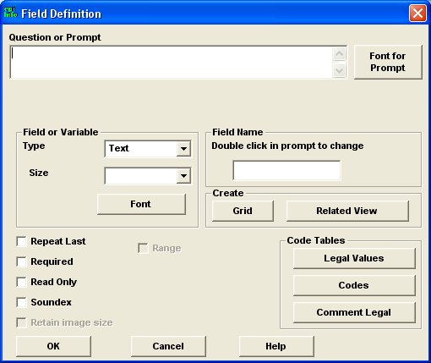
Creating fields in Epi Info
Right click on the Make/view window (Grid)
A Field Definition dialog box will appear

Slide 37
Components of the Field Definition dialog Box
Question or Prompt - creates the text that will appear on the questionnaire.
This text can be a variable name, the title of the survey, the subtitle of the survey, etc.
“Font for Prompt” button to format the font - font style, and size of the text

Slide 38
Field Types in Epi Info
Text
Text(Uppercase)
Label/Title
Multiline
Number
Phone Number
Date
Time
Date/Time
Yes/No
Check Box
Option
Image
Command Button
Mirror
Grid
Relate

Slide 39
Field Definition dialog box
“Field or Variable Type”- the type of the variable such as numeric response, text, yes/no, date, time, etc.
“Pattern” – defines specific types of fields or variables such as: number, phone number, date, time, and date/time.
“Size”- defines the length of the text when type is specified as text or text(uppercase).

Slide 40
Field Definition dialog box
“Field Name” - label of the variable or text.
Then click on “OK” button to add the variable on to the View.
It can be located by dragging on the screen.

Slide 41
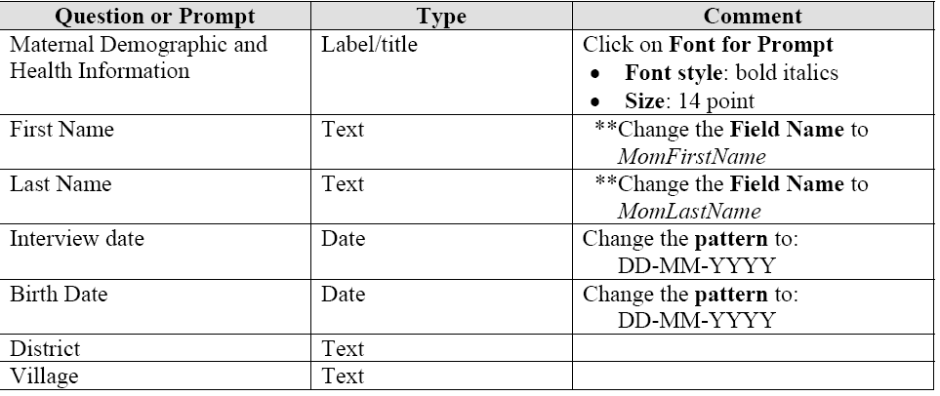

Slide 42
Adding Drop Downs
Lets Create a drop down to enter the “City”
The answers are “Kandy, Colombo, Galle, Jaffna”
Enter the Field Name as “City”
Select the type as “Text”
Click on “Legal Values” button to enter the list of answers.
Create the Answer list

Slide 43
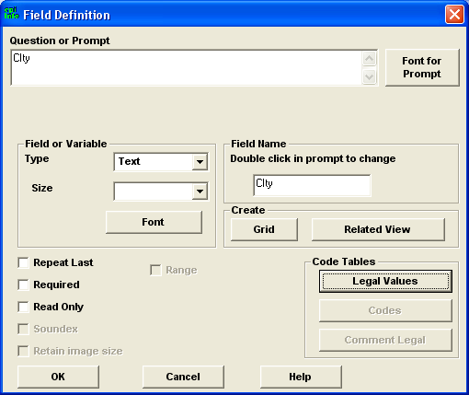
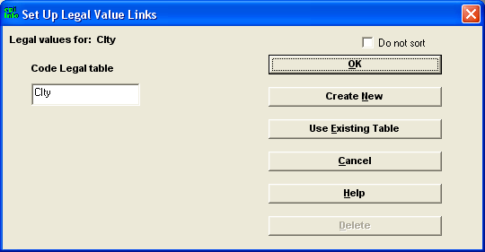

Slide 44
Add Radio Buttons
Sex of students. The answer are “Male” or “Female”
Enter the name of the field as “Sex”
Select the type as “Option”
Then Click “Ok” will appear a new dialog box to enter the choices (Answers)

Slide 45
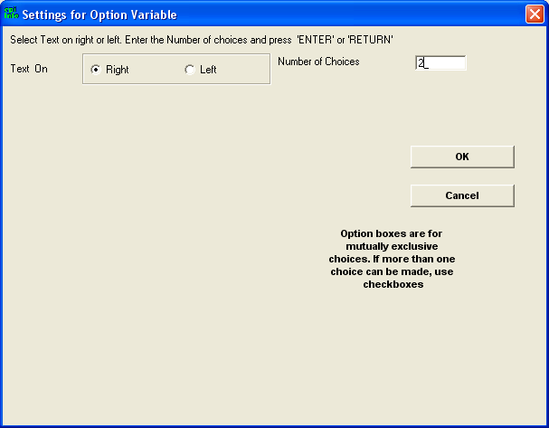
Click on the “Enter key” to add the choises.

Slide 47
Yes/No Questions
Are you Married? Will have only Yes or No answer
Enter the field name and select type as “Yes/No”

Slide 48
Creating grids in the questionnaire
Are added through the field definition dialog box.
Create several variables under one heading

Slide 49
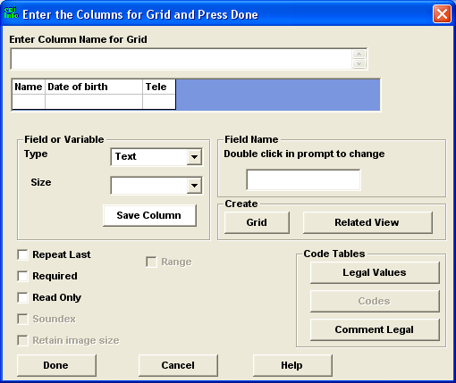

Slide 50
Creating groups in the questionnaire
Place the variables under a different sub-title to make it easier to identify that are asking for similar information.
Move the variables closer
Select them
Insert → Group → name the group

Slide 51
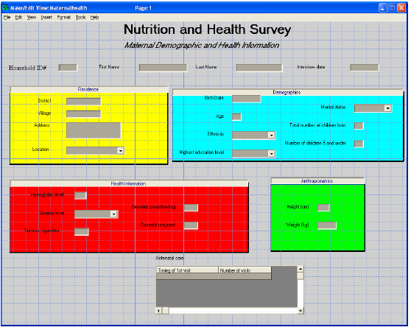

Slide 52
Change the Background
Format→ background

Slide 53
Selecting the Tab Order
This makes easier to enter data without using the mouse.
Move from field to field using the tab key
Edit→ Order of Fields
From there move fields up and down to arrange the tab order

Slide 54
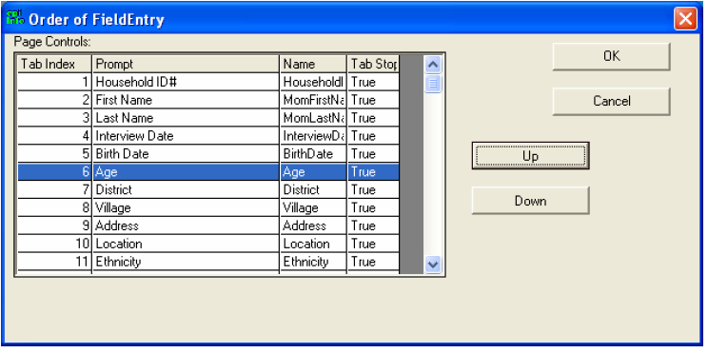

Slide 55
Entering data to the Questionnaires
Epi Info

Slide 56
Enter Program
Open the “Enter Programe” of Epi Infor to insert data
Open the questionnaire and the project
Enter the data for the first Record
Click the Save data button to add the record

Slide 57
Navigate through Records
Use the following set of buttons to navigate through entered records

Slide 58
Deleting records
Navigate to the record to be deleted
Click on the “Mark Record as Deleted: button
Then the Records will not be deleted. But the it is not accessible
You can Recover (Undelete) the deleted record using the “Undelete” button

Slide 59
Analyzing Data
Epi Info

Slide 60
Sorting data
Open the “Analysis” program from EpiInfo
Choose the Read(Import) command from the Analysis Command Tree.
Select the data format as Epi 2000
Select your data table(form)

Slide 61
Listing Sorted data
Choose the Sort subcommand from the Select/IF folder within the Analysis Command
Double click on the variable to be sorted
Click the OK
Choose the List command from the Analysis Command tree.
Choose a variable to list. Data are sorted by the above selected field

Slide 62
Cancel the Sorting
To cancel the sorting criteria select “Cancel Select” from the Analysis Command tree

Slide 63
Thank You …….

